Slide 1
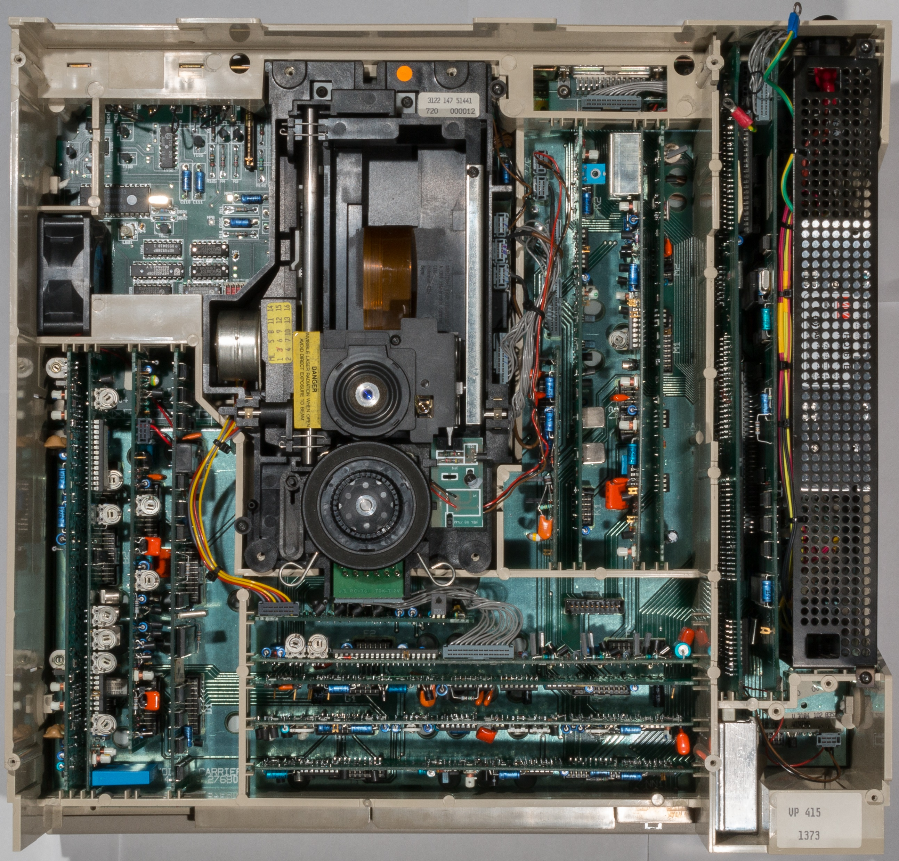
T - Supply
U – Analog I/O
K – HF Processor
Z – Deck Electronics
R – Drive Processor
C – Video Processor
S - Control
L – Video D.O.
M - Radial
J - Focus
B - RGB
A - Audio Processor
E – Slide Drive
F – Motor & Sequence
D – Reference Source
G - Genlock
H – ETBC B
I – ETBC C

